Slide 1
Big Data Analytics - Airmech case study
- Su Yang

Slide 2
Goals
Step1: Collect monetization and in-game behavior data.
Step2: Predict the likelihood a player is going to leave the game, understand why, take decisions and actions to retain players.
Step3: $$$$$

Slide 3
Scope of Data
Monetization data (27 columns, 6742683 rows)
In-game behavior data (53 columns, 49203678 rows)
2.8 billions data points… (therefore Big Data)

Slide 4
Scope of the Data
Reduced to: Level 3 or up (77% of all players); first 15 days.
Players who will stop playing one week later are considered Leavers.
We train/test the algorithm on old gen data, and make predictions on the new gen data.

Slide 5
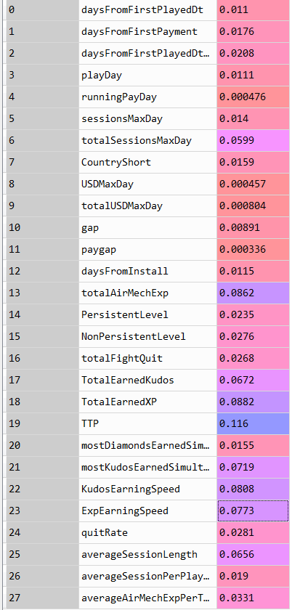
What metrics should we use?
Metrics Importance
Not all of the 80 parameters influence the outcome of the algorithm; use of non-relevant parameters will overfit the model by creating noise.
This first step needs market intelligence (via an expert) and an understanding of players’ psychology.
Total Time Played has the most influence on the outcome

Slide 6


Model Validation
44.8% are leavers on old gen, 46.1% are predicted to leave in one week on new gen, results are consistent.
F-score = 0.68 (industry benchmark = [0.5,0.7].) -> above average.

Slide 7
Results
Metrics Importance
Average Session Length and Total Sessions are decent indicators of players interest, (confirmed expectations).
Drops in those metrics show interest loss, providing opportunity to re-engage player before losing them.
Sessions-related decent indicators

Slide 8
Results
Metrics Importance
Kudos and Exp earning speed are very strong interest indicators.
Player plays faster = faster Kudos/Ex gain = interests to the game. Slowing down the rhythm means they are no longer hooked. How can we change that?
3rd and 4th important indicators are speed-related

Slide 9
Results
Metrics Importance
The Most Kudos Earned After A Game is a surprisingly key factor. (highest reward)
Insight: Anchoring and Optimism Bias (“casino symptom”). higher reward peak will increase retention.
Proposal -> create a crazy Wednesday with random +5% to 20% reward during 6 hours?
5th Element

Slide 10
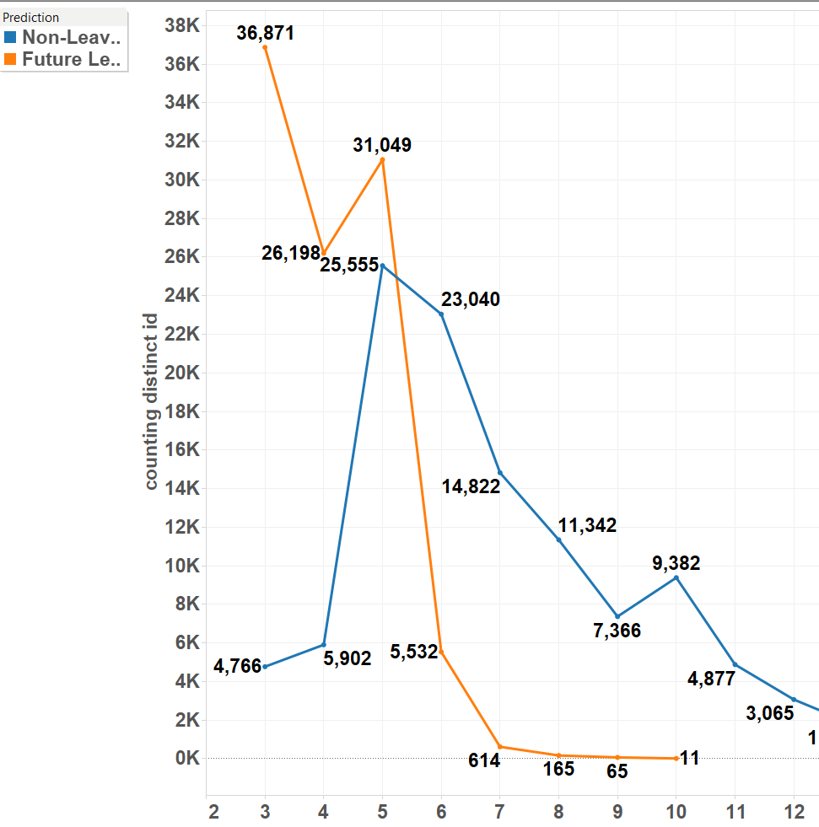
New achievement?
Pic on lv 3 (model bias) and 5 (has real value) for future leavers.
Need new achievement/ reward for better retention rate on lv 5.
Proposal: unlockable achievement at lv 5: “Gain exp/win game with a certain Airmech”

Slide 11
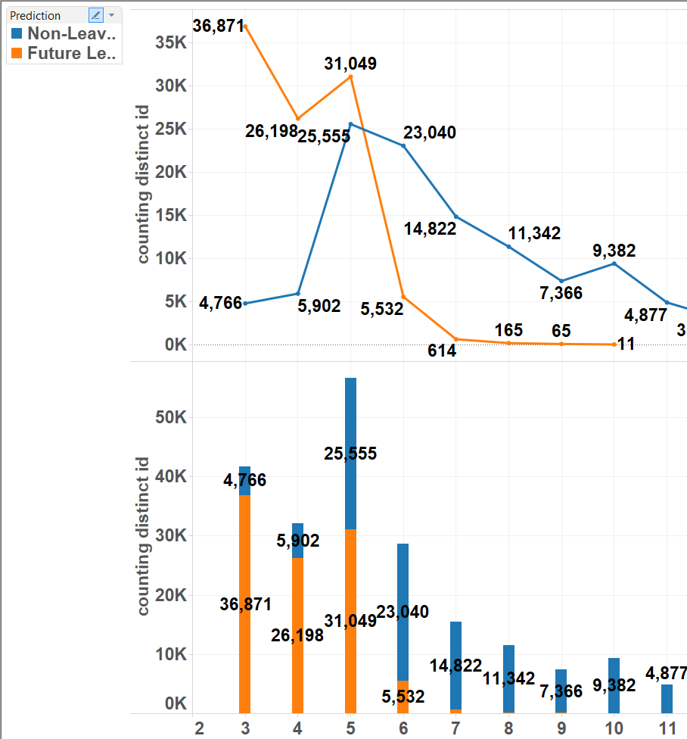
Level distribution
Leavers: 93.6% have lv 5 or less.
One more lv at lv 5: 45.1% -> 80.6% likelihood to keep playing.
Proposal: add “resolve” bar filling up along played games. Full bar gives +50% exp.

Slide 12
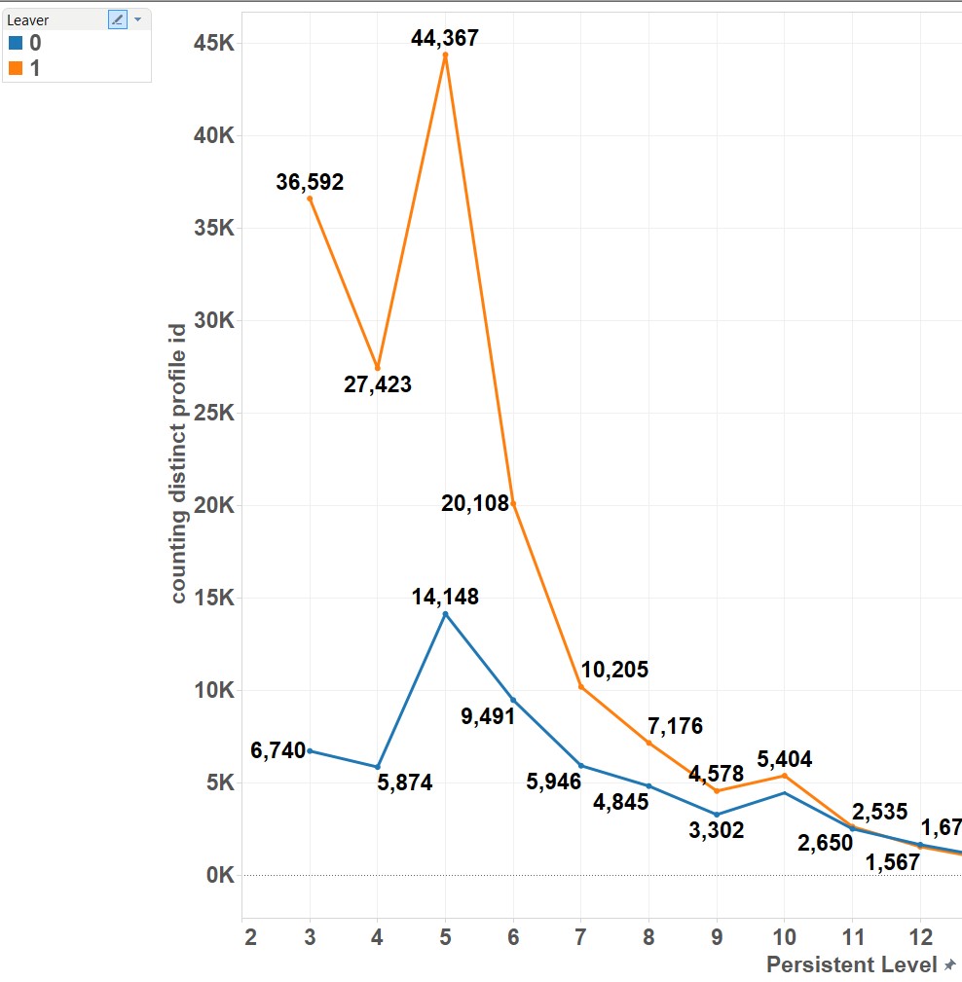
Level distribution (real)
Beware: the inactive period is under 2 weeks, so the “real” data is biased towards leavers.

Slide 13
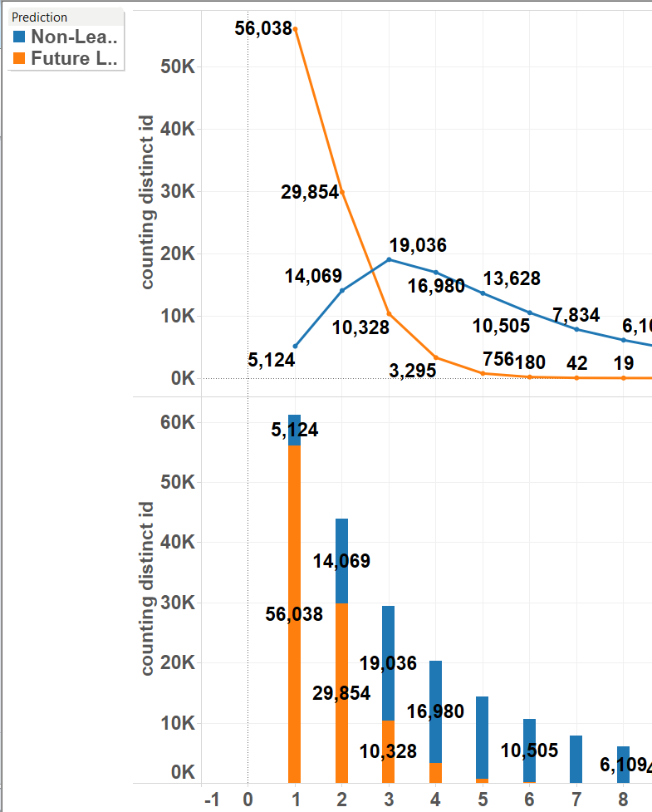
One more session?
Leavers curve is steeper than standard curve.
95.7% of leavers play 3 sessions or less (roughly 1 every 5 days). [install day]
One more session at 3 session: increase from 64.8% to 83.7% likelihood to keep playing.

Slide 14
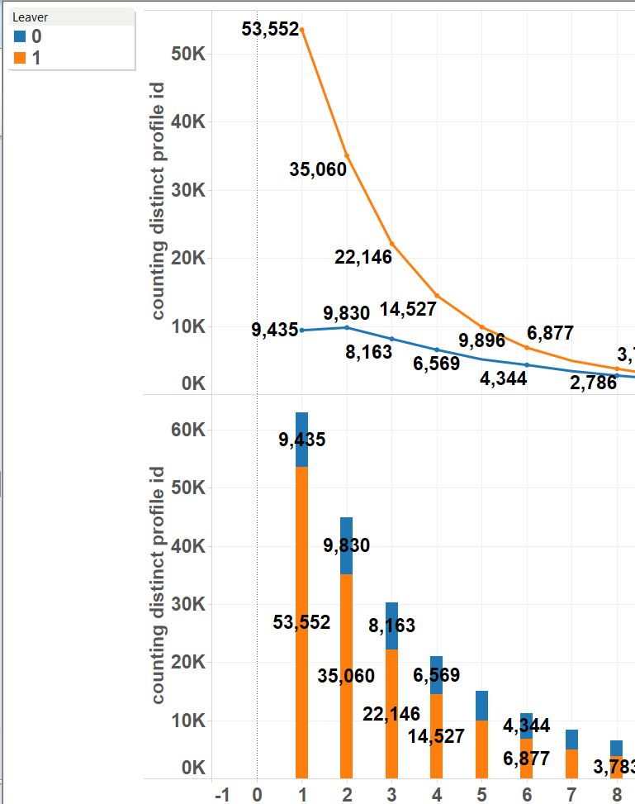
One more session? (real)
Beware: the inactive period is under 2 weeks, so the “real” data is biased towards leavers.
Proposal: The first victory every Xh (48?) gives double exp.

Slide 15
Conclusion
Big Data Analytics in video games:
Yes, it is all about Retention/Conversion.
(By understanding players’ behaviors better)

Slide 16
Appendix: What we really did:
Start the process with “predicting whether a player leaves” in mind.
Refine algorithm via metrics/range selection and model optimization.
Corroborate commonly accepted key metrics (TTP)
Find unexpected key metrics and understand why.
3 ways of using the outcome:
Predict player’s likelihood to quit and expected value lost.
Use relevant metrics (expected or unexpected), to track players’ interests; raise red flag if need be.
Make design/marketing strategy tweaks accordingly to improve retention rate.

Slide 17
Appendix: Philosophy of Data Science
Data Science is not:
Creating the perfect algorithm.
Using all available data to predict an outcome.
Data Science is:
Understanding data better.
Finding and creating relevant metrics.
Thus analyze/understand/predict players’ behavior and make deterministic measures.
All this by improving algorithm’s efficiency.

Slide 18
Appendix: Conclusion
Predictive analytics != Forecasts.
Improving Machine Learning algorithm is not the end: it is means to finding patterns in players’ behavior that we can’t otherwise.
Objective: Understand players’ behavior, find relevant metrics, thus enable smarter decisions.

Slide 19
Appendix: The real work
As of 5/27/2015 there are 289,861 PS4, 307,749 Xone and 1,722,950 X360 players.
What takes time? (if left to one person):
Understanding data by looking at them, playing the game, talking to experts (couple of weeks)
Deciding the parameters and range, writing the fetching pipeline (SQL), prepping and learning pipeline (Python) (a few days)
Run the SQL/Python script, each iteration takes 15 minutes, and considering the number of features/players, one needs at least hundreds of iterations before anything concrete can be exploited (a few weeks).
Analyze data and find reasons by reading psychological traits, competitors’ examples' surveys (a few weeks)
In total it takes roughly 3 months one-person time to do a proper analysis on one game which cannot be scaled because every game is very different.

Slide 20
Appendix: Skills needed
Technical requirements:
Very strong in SQL.
Software experience in any language with external file system in order to prep the data.
Strong in Python(Scikit-learn)/R/Scala+Spark: or any language with a strong learning library.
Very strong in a data visualization software (Tableau)
Good in statistics and probabilities.
Very strong business sense (need to ask the right questions, understand the why behind the how). We want people to understand the data in the end, not the machine.
(Optional) Knowledge in sociology, psychology, physiology/neuroscience and in video games.

Slide 21
Results (archive)
Metrics used Weights on outcome
Total Time Played is the most important metric.
As a player plays less, he/she is more likely to leave soon(no surprise there).
TTP has the most influence

